Slide 1
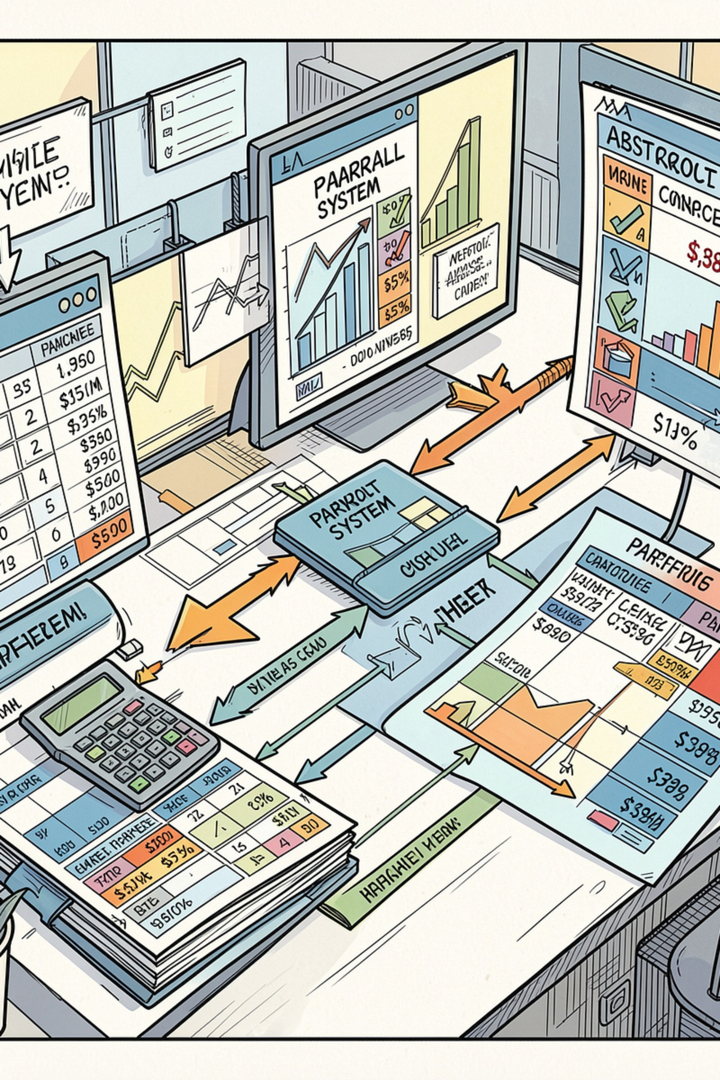
Employee Payroll and Statutory Deduction Management System
Muneeb Siddiqui · 25WU0102265
SUBJECT : DBMS

Slide 2

The Core Problem
Calculation Errors
Compliance Risk
No Single Source of Truth
Manual computation of gross pay, tax, PF/ESI, and loan EMIs is prone to formula slips, rounding inconsistencies, and human oversight—leading to incorrect employee compensation and financial discrepancies.
Statutory limits such as PF contribution ceilings, income tax slabs, and outstanding loan balance caps are easily overlooked in spreadsheet-based systems, exposing the organization to regulatory penalties and legal liability.
Attendance records, salary structures, and deduction data are scattered across separate files and systems that frequently fall out of sync, making audits difficult and decisions unreliable.

Slide 3
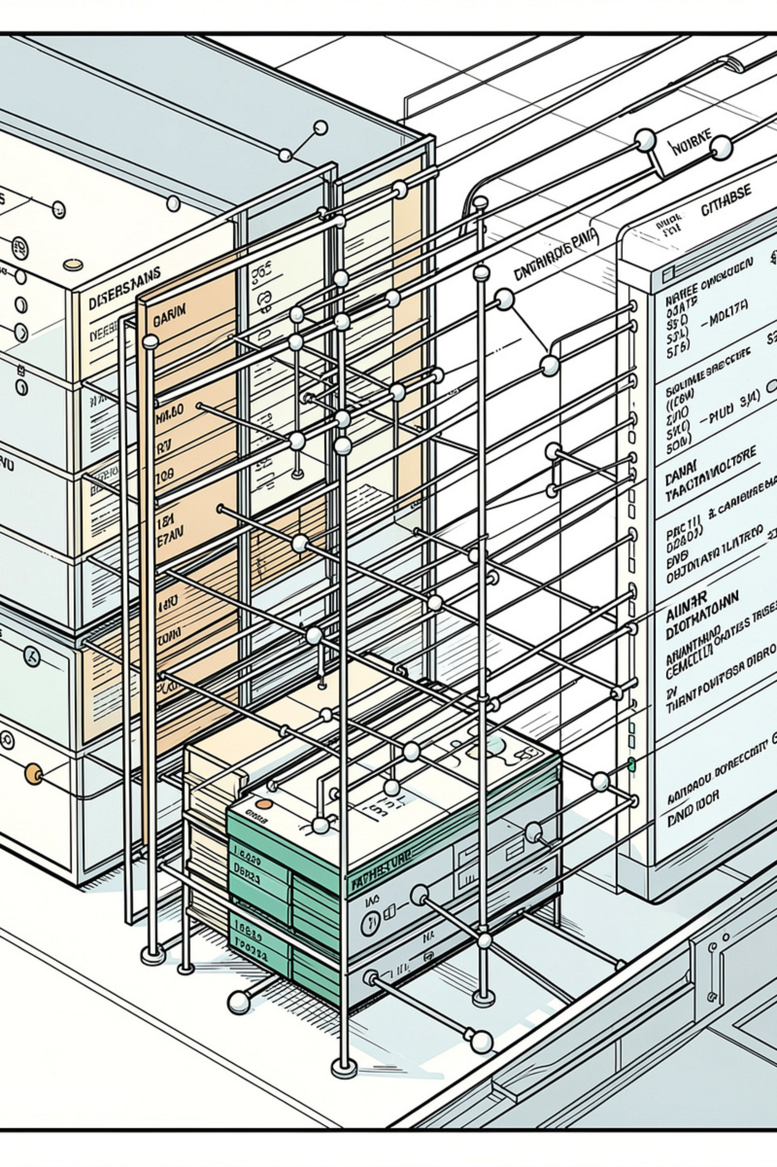
Project Objectives
1. Eliminate Manual Errors
2. Automate Gross & Net Pay
Replace error-prone spreadsheet formulas with validated, database-enforced calculations for every payroll run.
Compute gross pay, deductions, and net pay automatically from attendance and salary structure records.
3. Enforce Statutory Limits
Apply statutory deduction ceilings and outstanding loan balance rules directly at the database level.

Slide 4


Conclusion
This conceptual model and relational schema give the Payroll & Statutory Deduction Management System a single, validated source of truth — replacing error-prone spreadsheets with enforced business rules for compensation, compliance, and disbursement.
Normalize to 3NF
Eliminate redundancy and ensure data integrity
Define Constraints
Enforce business rules and referential integrity
Build Payroll SPs
Implement secure, auditable stored procedures

